Slide 1
Evidence- Based Practice and Quality Improvement in Nursing Care
Jennifer Schulz, BSN, RN
This Photo by Unknown author is licensed under CC BY-SA-NC.

Slide 2
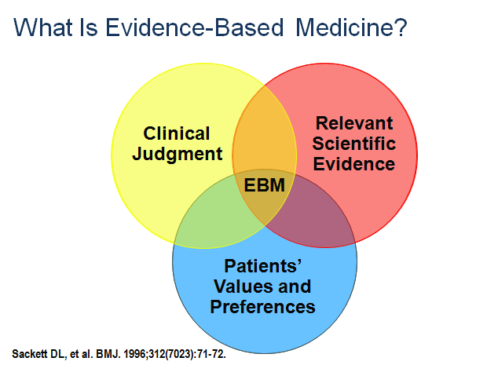
Definition
“The conscientious, explicit, and judicious use of theory-derived, research-based information in making decisions about care delivery to individuals or groups of patients and in consideration of individual needs and preferences.” (Ingersoll, 2000)
“An ongoing process by which evidence, nursing theory, and the practitioners' clinical expertise are critically evaluated and considered, in conjunction with patient involvement, to provide delivery of optimum nursing care for the individual.” (Scott, 2009)
Use of evidence to guide practice while considering patient involvement
This Photo by Unknown author is licensed under CC BY-NC-ND.

Slide 3
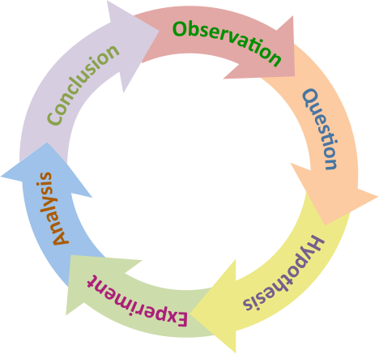
Scope of EBP
Scope of evidence
Ranges from discovery of evidence to delivery of care
The scope is used in numerous ways:
The focus on research based on patient care needs
Translational research advances patient care goals
This Photo by Unknown author is licensed under CC BY-SA.

Slide 4
Attributes and Criteria
Attributes of evidence
Replicability
Findings are verified when repeated in other studies
Reliability
Findings are consistent (e.g., a treatment given for similar disorders leads to similar outcomes)
Validity
Accuracy of application and findings
This Photo by Unknown author is licensed under CC BY.

Slide 5
Attributes and Criteria
Evidence on the Internet
Quality of evidence must be critically evaluated
Determine the author and sponsor of the information
Determine the domain—such as .edu, .gov, .org
Evaluate popularity
Checklists can help evaluate online information
Currency, Relevance, Authority, Accuracy, Purpose
This Photo by Unknown author is licensed under CC BY.
Notes:
Discuss the process of a scholarly literature search.
Ask students to locate high-quality, evidence-based information on a defined topic on the Internet.

Slide 6
Context to Nursing and Health Care
Steps for using evidence to systematically approach questions of patient care
Develop an answerable question
Search the literature
Evaluate the evidence
Apply the evidence
Evaluate the outcome
This Photo by Unknown author is licensed under CC BY-SA-NC.
Notes:
What are factors nurses should consider when developing a research question?
Discuss the need to incorporate patients’ preferences when implementing evidence-based care.

Slide 7
Quality improvement-is a continuous process involving all levels of the organization working together across departmental lines to produce better services for health care clients. Quality Improvement is an umbrella term that covers all concepts related to :
Quality assurance--the provision of services that meet an appropriate standard.
Problem resolution--including all departments involved in the issue at hand.
Quality improvement: the nurse's role - PubMed (nih.gov)

