Slide 1
Chapter 5
System Design and Acquisition

Slide 2
SYSTEMS DEVELOPMENT LIFE CYCLE (SDLC) AND HRIS DESIGN
SDLC provides a structured approach to the design of the HRIS

Slide 3
DESIGN CONSIDERATIONS
Logical design
Translation of business requirements into improved business processes, irrespective of any technological implementation
Physical design
Determining the most effective means of translating business processes into a physical system that includes hardware and software

Slide 4
LOGICAL DESIGN: DATA VS. PROCESS PERSPECTIVE
Data perspective
Focuses on an analysis of what data the organization captures and uses, its definitions and relationships
Process perspective
Focuses on business processes and activities in which the organization engages and how data flow through the HRIS
Both are essential to understand
the complete picture of an HRIS!

Slide 5
DATA FLOW DIAGRAM (DFD)
Graphical representation of key business activities/processes conducted by the organization
Focus is on the transformation and movement of organizational data
Can move to and from external entities (such as a job applicant), processes (the applicant tracking process), and data stores

Slide 6
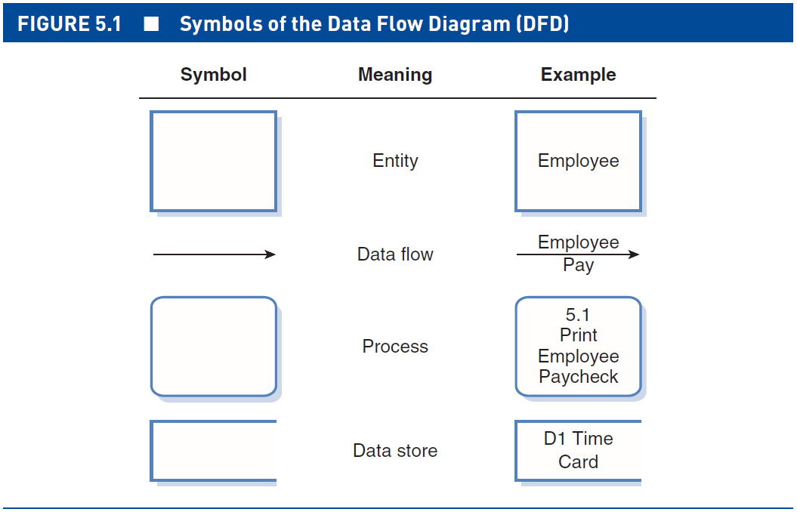
SYMBOLS OF THE DFD

Slide 7
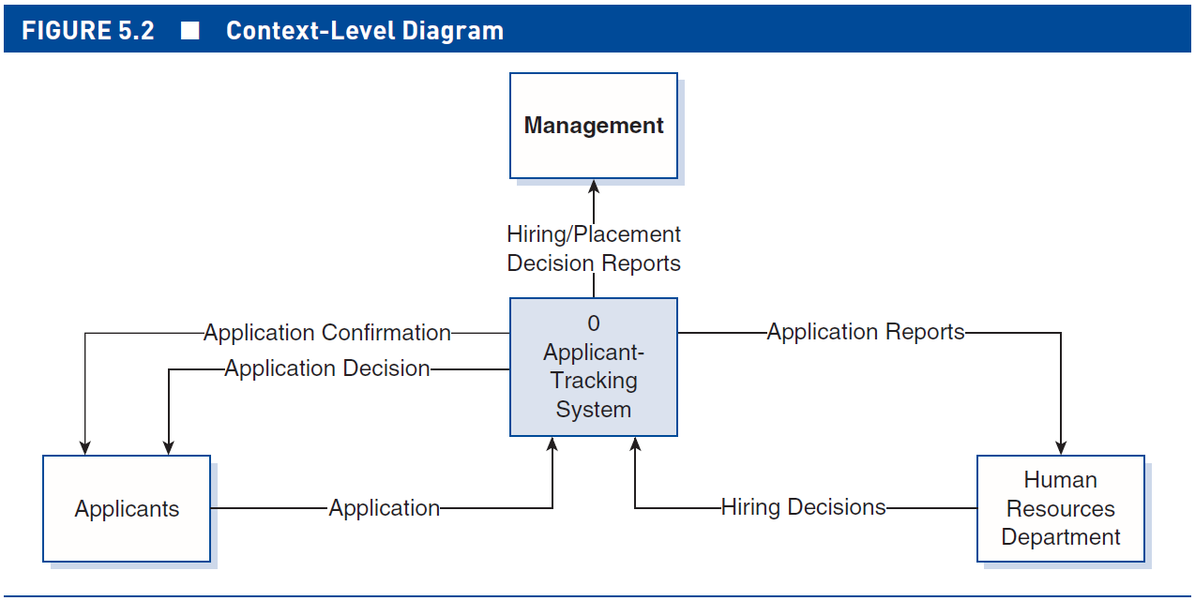
DFD: CONTEXT-LEVEL DIAGRAM

Slide 8
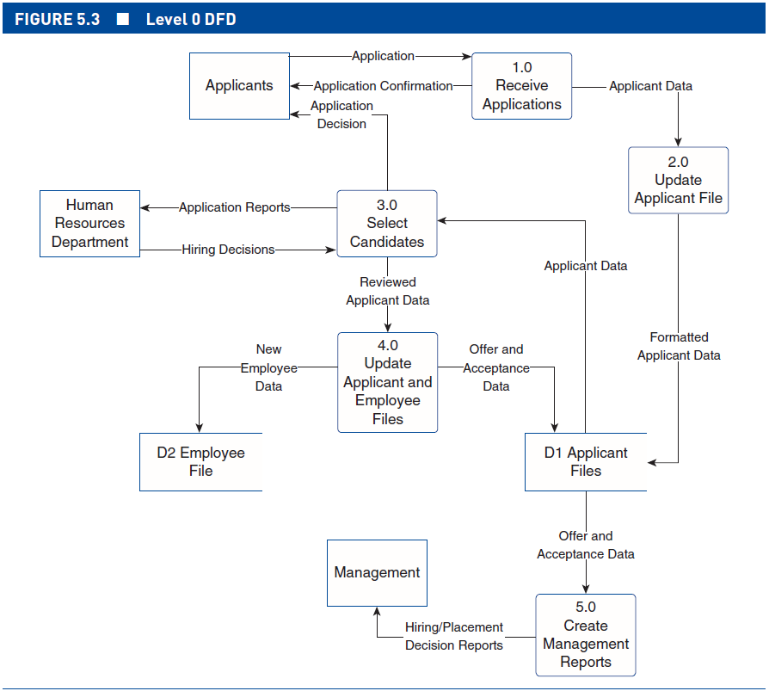
DFD: LEVEL 0 DIAGRAM

Slide 9
PHYSICAL DESIGN
Major activities
Determine if value in moving forward with implementation of new system
Determine hardware and software options and requirements
Determine where to obtain hardware and software
Develop implementation schedule
Work with potential vendors, and select software, if obtained externally

Slide 10
THREE CHOICES IN PHYSICAL DESIGN
Do nothing
Make changes to HR processes without new/ upgraded technology (which is only a tool, not a solution)
Implement changes with new or upgraded technology
Build in-house
Buy it (commercial off the shelf [COTS])
Outsource development
Most common

Slide 11
WORKING WITH VENDORS
Request for proposal (RFP)
Document that solicits proposals and bids for proposed work from potential consultants or vendors
RFP recommendations
Focus on the business requirements
Be specific
Keep it simple
Work closely with HR and IT staff

Slide 12
WORKING WITH VENDORS
Vendor selection considerations
Functionality
IT architecture and integration
Price
Vendor longevity and viability

Slide 13
ASSESSING SYSTEM FEASIBILITY
Technical
Focuses on current technological capabilities of the organization and the technological capabilities required for the implementation of the proposed system
Operational
Focuses on how well the proposed system fits in with the current and future organizational environment

Slide 14
ASSESSING SYSTEM FEASIBILITY
Legal
Focuses on adhering to existing laws and regulations
Political
Focuses on the political environment of the organization in which the HRIS is being implemented
Economic
Focuses on the costs and benefits of the new system

